Slide 1


Community Service Project
Smart solutions for Rice Mills
By
V. Venu (22481A04N9) S. K. Mohana Rao (23485A0432) P. Prem Sagar (22481A04J7) S. Jessi (22481A04M4)
Guide : Ms. M. Deepikakrishna,M.Tech (Assistant Professor)
Department of Electronics and Communication Engineering
SESHADRIRAO GUDLAVALLERU ENGINEERING COLLEGE
SESHADRI RAO KNOWLEDGE VILLAGE GUDLAVALLERU-521356
1

Slide 2
Contents
Objectives of the Work
Abstract
Introduction & Importance of the Work
Rice Milling Processing
Details of the Workplace Visited
Activities Conducted/Observed
Problems Identified
Solutions/Improvements Suggested
Conclusion
2

Slide 3
Objectives of the Work
Raise awareness about sensor usage in rice milling.
Improve the efficiency of rice milling operations.
Learn about rice milling process, equipment operation, and quality control.
Suggest solutions for rice mill modernization.
4

Slide 4
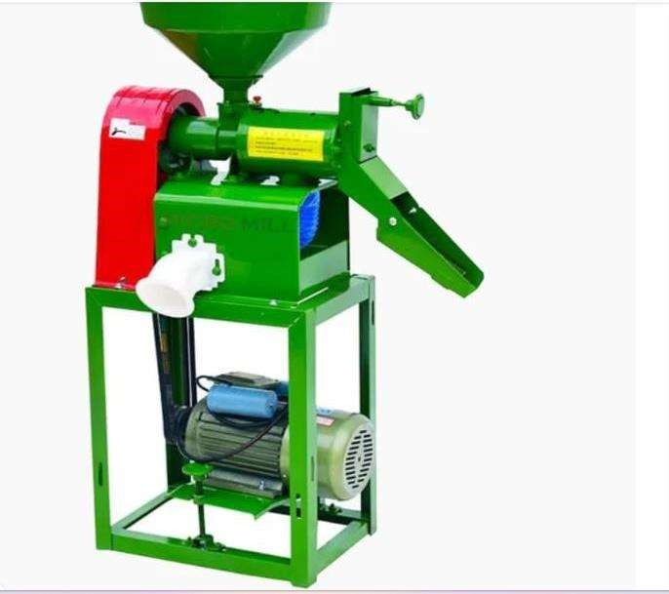
Abstract
The project focused on understanding the problems in traditional rice milling at Sri Seshadri Rice Mill, Gudlavalleru. The team explored issues faced by the workers and recommended modern technological upgrades such as sensor integration and automation for energy optimization and better grain sorting.
A compact rice machine is a portable device that de-husks and polishes rice, ideal for small-scale use. It's efficient, user-friendly, and saves space for small farms or personal use.
Fig 2: Compactable Rice Milling Machine
5

Slide 5
Introduction & Importance of the Work
Introduction
Importance
The project titled “Smart solutions for Rice Mill" focuses on improving the traditional rice milling process by integrating modern technologies.
This project addresses inefficiencies in traditional rice mills and highlights the potential for modern technology to improve the process, benefiting both workers and productivity.
Rice is a global staple, and efficient rice milling is crucial for the industry. India is one of the largest producers of rice, and modernization of rice mills can greatly enhance productivity and quality.
Traditional rice mills in rural areas like Gudlavalleru are often not equipped with modern machinery, resulting in inefficiencies and low productivity. By introducing automation, sensor technology the productivity and quality can be improved.
3

Slide 6
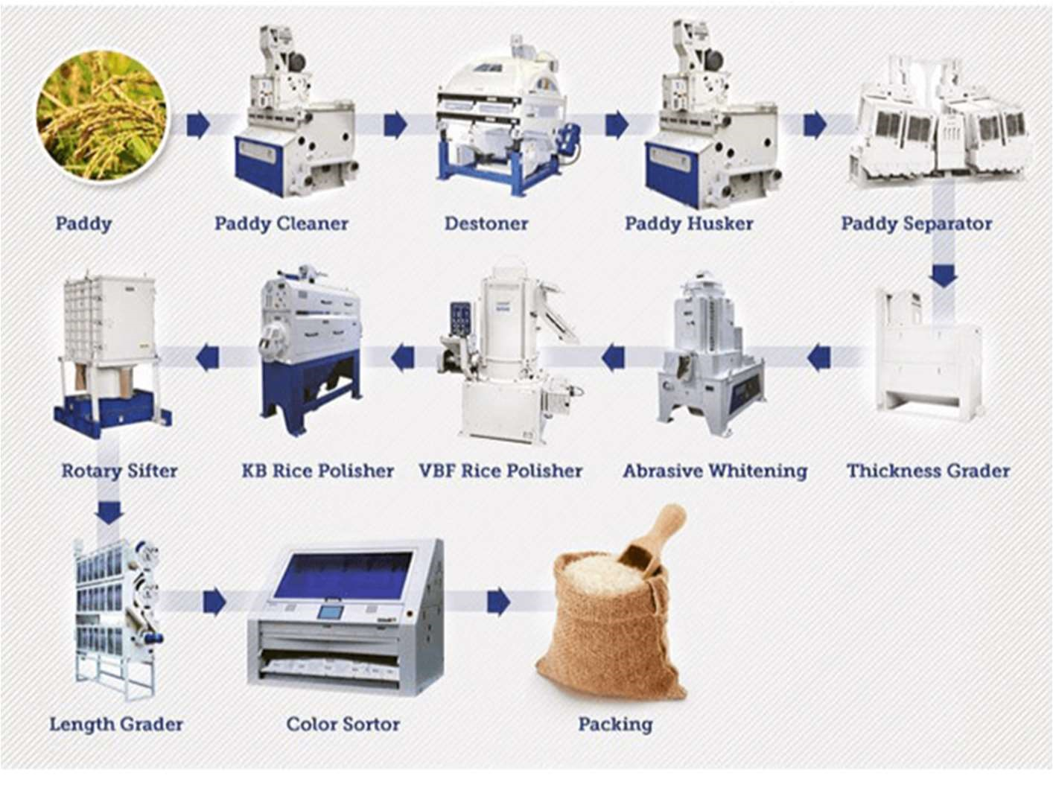
Rice Milling Processing
1
Cleaning
2
Stone Separation
3
De-husking
4
Paddy Separation
5
Polishing
6
Parboiling (Optional)
7
Sorting
8
Packaging
Fig 3: Rice Milling Processing
6

Slide 7
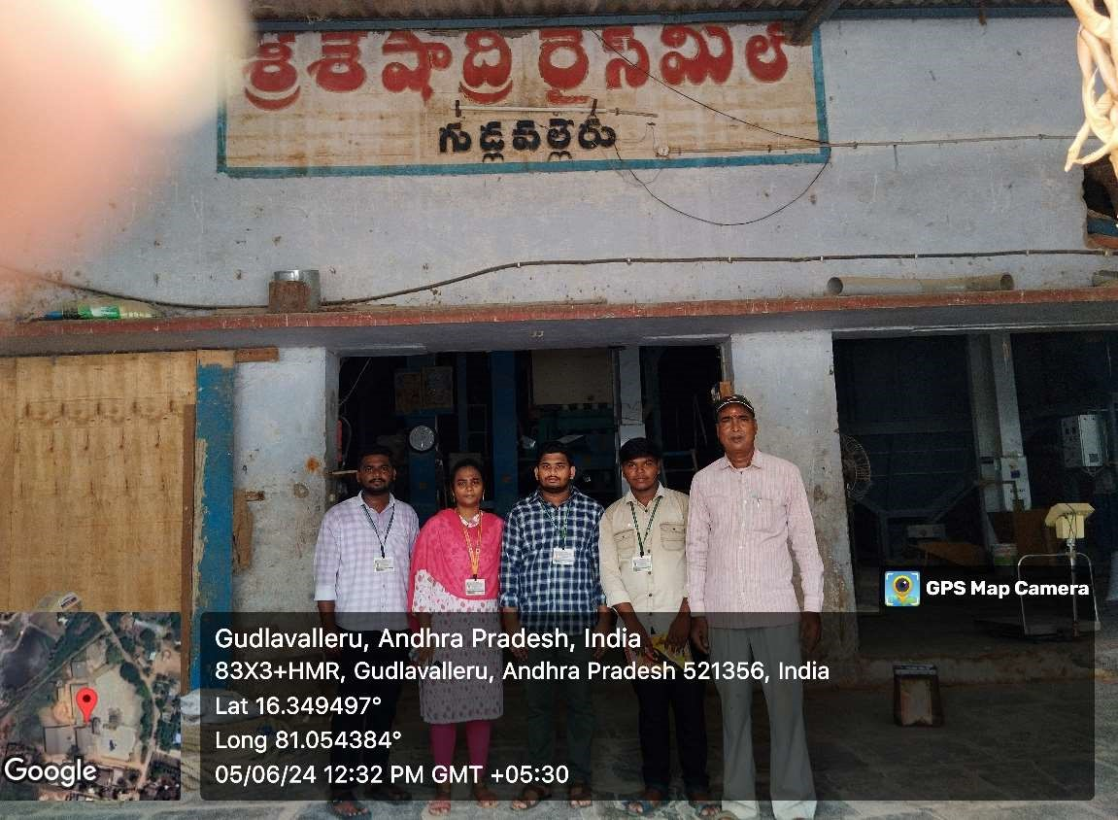
Details of the Workplace Visited
1
Workplace
Sri Seshadri Rice Mill, Gudlavalleru.
2
Location
Sri Seshadri Rice Mill, located in Gudlavalleru,
a rural area in Krishna district, Andhra Pradesh.
3
Focus
Fig 4: Work Place
The rice mill primarily uses traditional methods for rice processing, and the project aimed to introduce modern advancements.
7

Slide 8
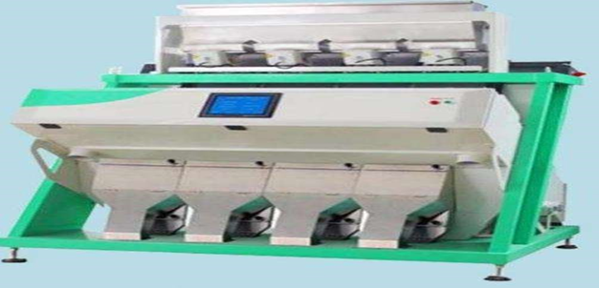
Activities Conducted / Observed
1
Week 1
Observed machinery , rice milling process and packaging of rice.
2
Week 2
Understanding about equipment maintenance and operations.
3
Week 3-4
Observing the waste management in rice mill and safety protocals
Fig 1: Sorting Machine
4
Week 5-6-7-8
Suggested solutions such as sensor integration and energy optimization systems.
8

Slide 9
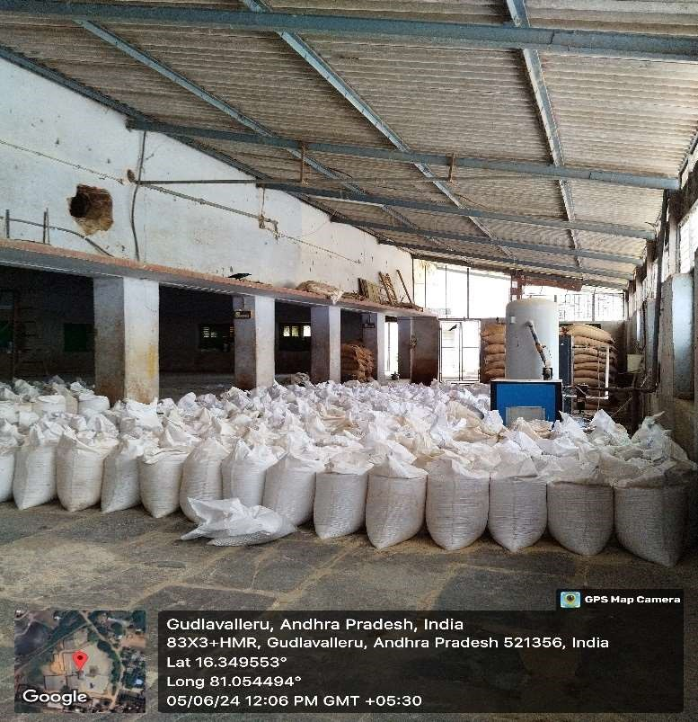
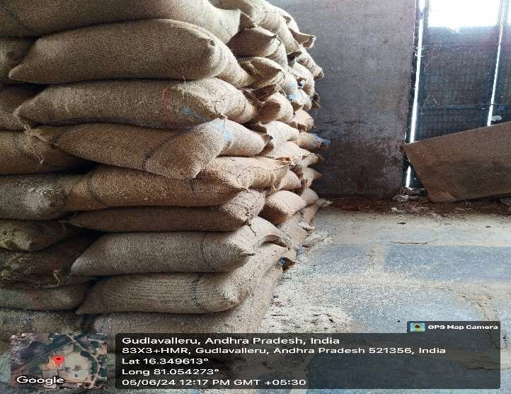
Problems Identified
1
Inefficient grain sorting
2
High energy consumption
3
Storage issues
Traditional methods of sorting rice grains lead to inefficiencies and lower quality output.
The equipment used consumes a significant amount of energy, increasing operational costs.
The mill faces issues in properly storing the rice, which affects the quality.
Labor shortages
Lack of adaptability to various rice varieties
4
5
There is a shortage of skilled labour to operate and maintain the machinery, further hindering the production process.
The mill has difficulty in adapting to different rice varieties.
Fig 6: Rice Storage Place
Fig 7: Storage Bags Of Rice
9

Slide 10

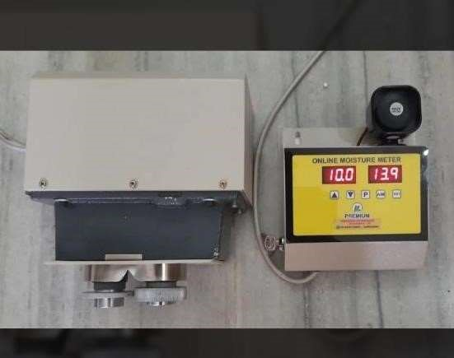
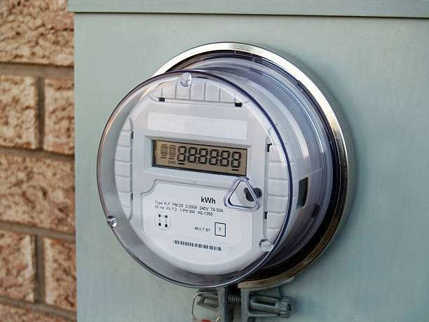
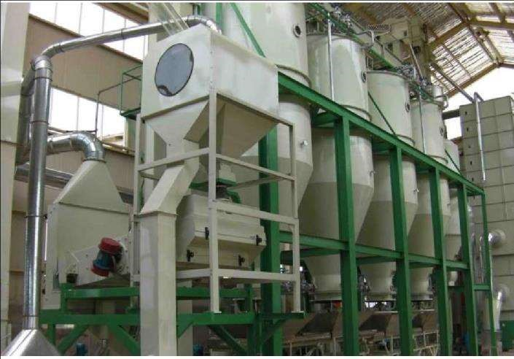
Fig 8: Moisture sensor
Fig 9: Picture of Smart Metering
Fig 10: Automated Rice Milling
Solutions / Improvements Suggested
1
Implement sensors to monitor storage conditions (temperature, humidity).
2
Introduce automated grain sorting and packaging systems.
3
Utilize smart meters for better energy management.
4
Invest in modern, efficient machinery for better productivity.
10

Slide 11

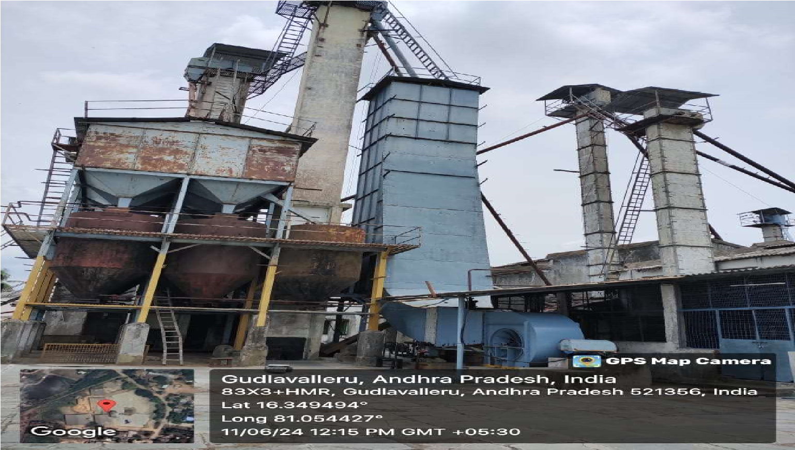
Conclusion
The project successfully identified major inefficiencies in traditional rice milling and provided recommendations for modernization, such as automation and sensor technology. These improvements can enhance production efficiency, reduce costs, and improve the quality of rice produced.
References
Information gathered from field visits, observations, and discussions with workers and management at Sri Seshadri Rice Mill, Gudlavalleru.
Fig 11: Rice Processing Machine
11

Slide 12
Thank you
12

Slide 13
ANY QUERIES?
13

